Slide 1
Binary Batch Distilation
By: Ameen Abuzir, Joshua Laforest, Javier Silva, and Cesearo Dilosa

Slide 2
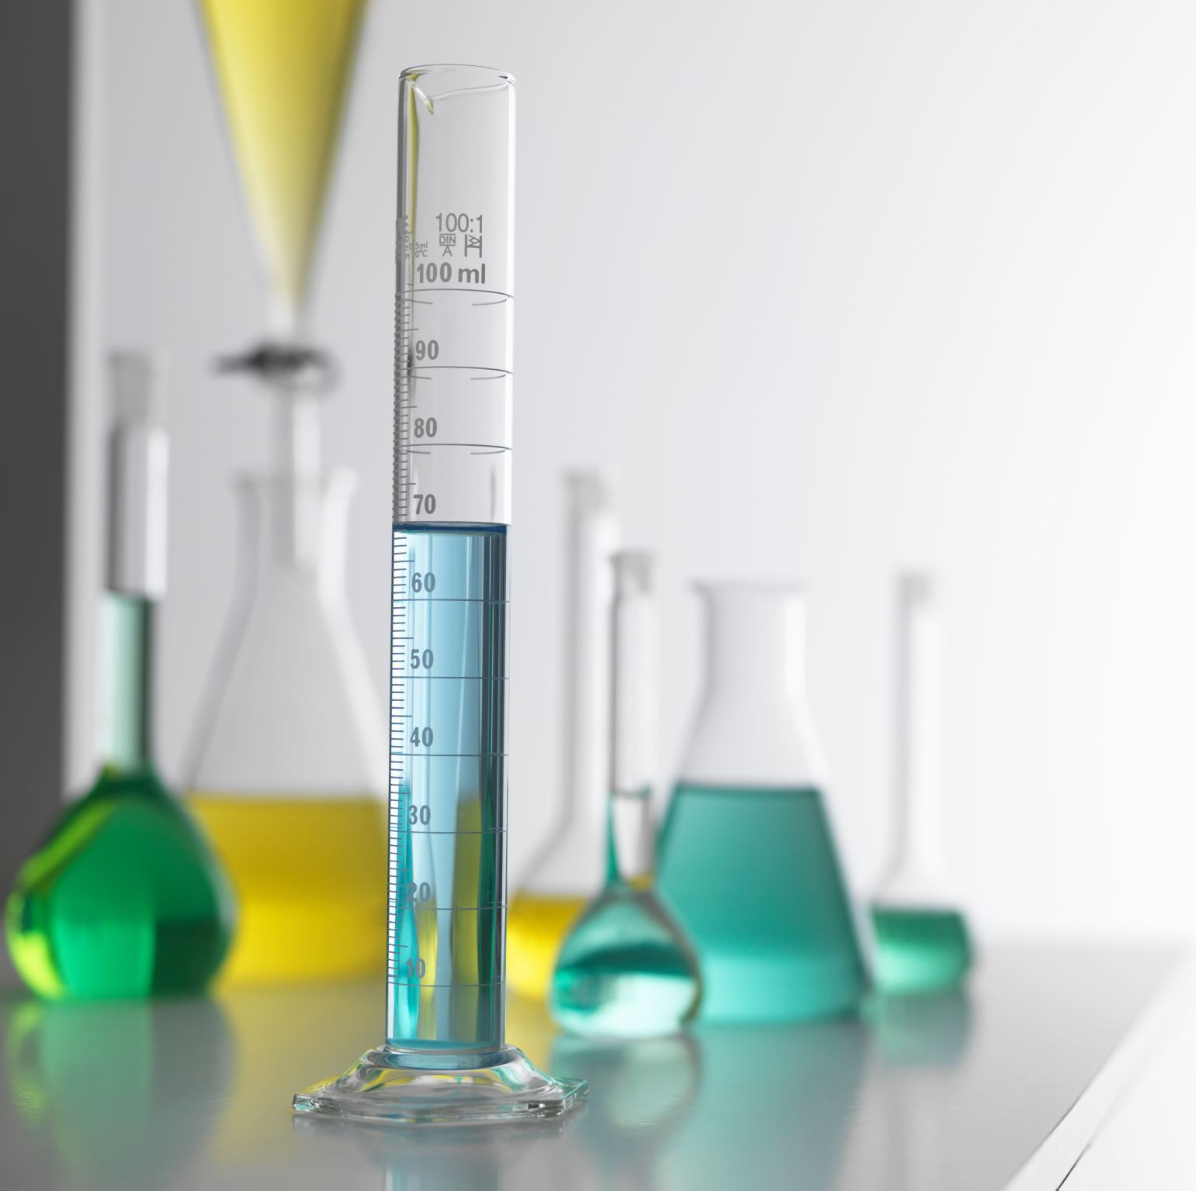
Purpose of lab
The objective of the lab was to determine the boil-up rates, top/bottom composition, pressure drop, and column efficiency of different reboiler power rates and reflux ratios
This is performed by pouring a 10 wt% ethanol and 90 wt% water solution into the reboiler and adjusting settings on the control panel

Slide 3
Technical nature of Distillation at different Temperature and Reflux ratios.
Impact in controlling the temperature in a distillation Collum.
At the top part of the Collum most of the distillate product is present due to the lower boiling point and at the bottom most of the solution is there usually resides in the lower part.
Controlling the temperature is important as sometimes the need for lower temperatures is needed to separate solutions in the stream. Having temperature too low will not separate the solution while to high will turn the whole solution into vapor not separating the solution.
Controlling the temperature mainly dependent on the boiling points of what needs to be separated.
Impact of reflux ratio on distillate.
The reflux ratio is based on product made and returned back into the reboiler.
The ratio is used to determine how to recycle the unseparated components in the distillate in order to find the best point in the vapor liquid equilibrium.

Slide 4
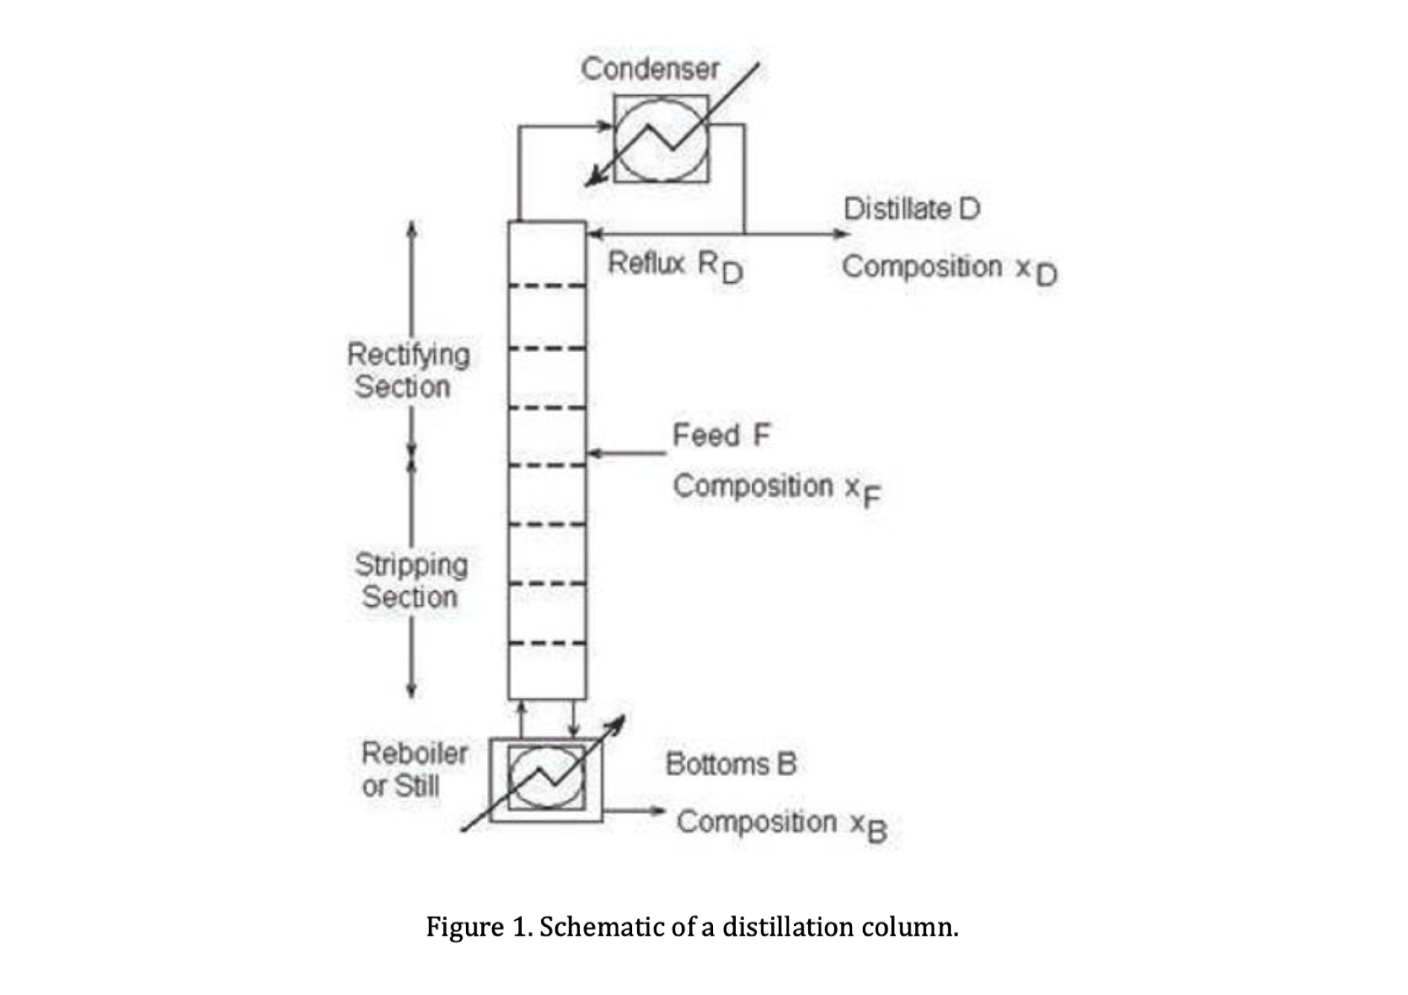
Theory of Binary Batch Distillation
Distillation is a common unit operation used in industry to separate components based on volatility. It works because when heat is added to a solution, more volatile components separate through evaporation. As heat is increased more of the volatile components will separate out.
This separation process can be made more efficient & effective by adding a column with stages for vapor and liquid to interact. In this column, some liquid (condensate) is being recycled downward and vapor is flowing upward. Each stage in the column will act as an equilibrium point where mass transfer can occur; also heat. This provides further separation and creates mini distillation steps in the column that aid in purer distillate and bottoms.
Further control over efficiency and effectiveness can be implemented through a concept called "reflux ratio". This ratio determines how much liquid is returning to the system to be further purified. A balance must be found with this ratio as there are economic & sustainability trade-offs for it being too high or too low.

Slide 5
Apparatus
Tray glass column | Allows for multiple stages where vapor and liquid meet to induce the separation of ethanol and water.
Immersion heater | Supplies controlled heat to the reboiler.
Condenser | Cools and condenses the water-ethanol solution into liquid distillate.
Feed tank | Stores the ethanol and water before being sent to the column.
Vacuum Pump | Reduces system pressure lowering boiling points.
Bottom Product Receiver | Collects the stream exiting the bottom of the column.
Heat exchanger | Transfers heat between the streams.
Reboiler | Heats bottom mixture to generate vapor to rise through the column.
Top Product Receiver | Collects the condensed distillate.
Decanter | Separates any possible immiscible liquid phases.
Manometer | Measures pressure drop in the column, monitoring the vapor flow and performance.
Vent | Releases gas safely from the system.
Reflux Valve | Controls the condensed distillate returned to the column.
Feed Pump | Delivers the solution from the feed tank to the column at controlled rates.
Cooling Water | Circulates through the condenser and heat exchanger to maintain condensation.

Slide 6
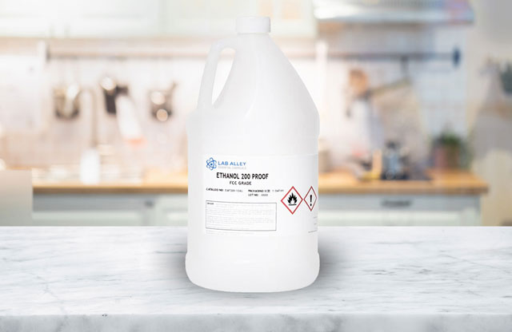
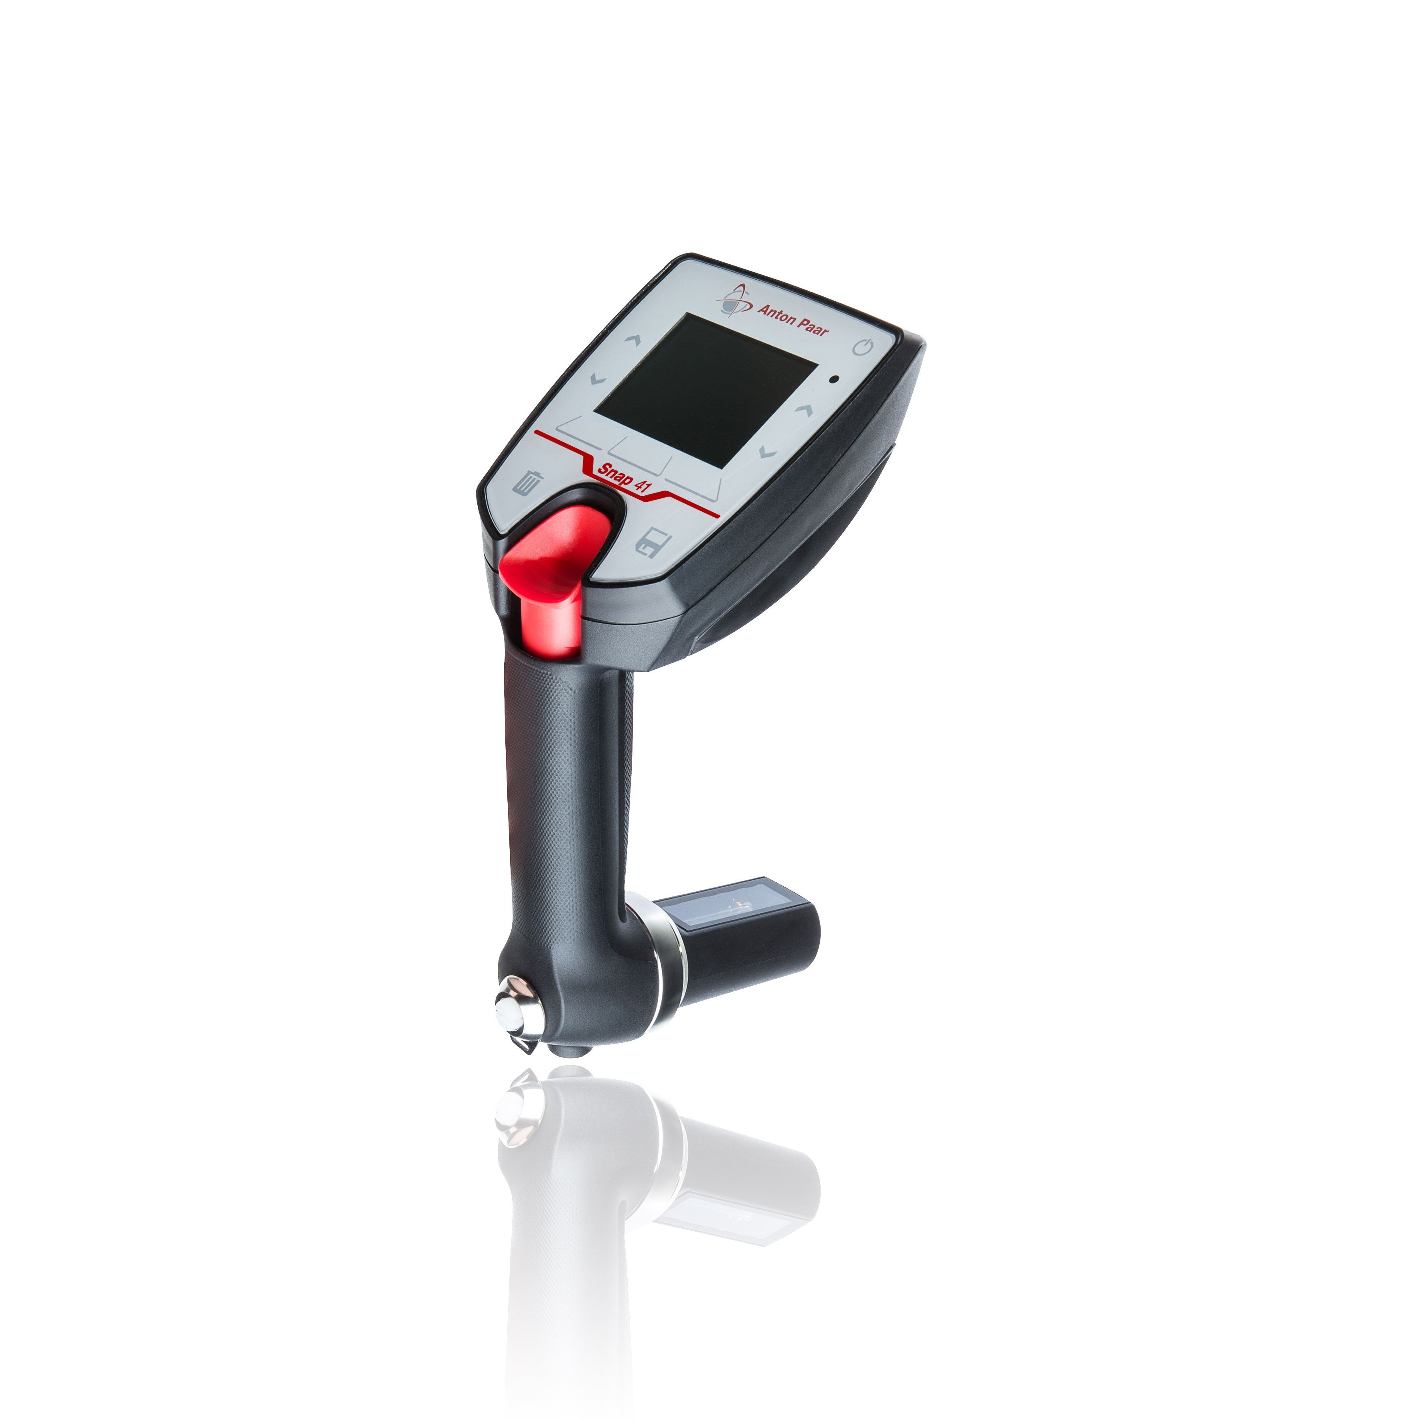
Material & Supplies
180 Proof Ethanol – Solution that will be separated from water.
Deionized Water - Solution that will be separated from ethanol.
Thermal Gloves - Protects hands when handling hot materials when extratcing.
Test tubes - Used to house and contain the solution distillated.
Ice/ Ice water - Used to cool collected samples.
Snap 41 - Used to read Alcohol content from sample extracted.
Graduated Cylinder - Used to collect the extracted distillate and help with measuring the flow rate.
Funnel - Helps the transfer of solutions to the reboiler.
Cooling water - Circulated through condenser to extract distillate.
Stopwatch - helped measure the time in the flow rate.
Built in operating System – Used to measure temperature at different valves.
Control panel - Controls voltage of reboiler and reflux ratio.
USB Flach Drive – Transferring data for analysis.
Thermocouples – built in to measure the temperature.

Slide 7
Procedure for Part A.
Mix 10 L of 10%wt Ethanol to 90%wt water.
Prepare equipment for the experiment by turning off the reflux ratio timer (on console), ensure all valves are closed, and open valve #10 to allow total reflux.
Set temperature to T9 (reboiler) and open valve #5 to allow cool water to flow to condenser until the flow (F11) is around 3 L/min.
Inset into the reboiler, turn on constant flow of cooling water and run system at 1.50 KW by flipping switch to ‘power on’ (a red light should come on until steady state is reached.
Open valves #6 & #7 and ensure there isn’t a pressure difference in the manometer, then close valves #6 & #7.
Wait for vapor to travel up the column and into the condenser. You will know vapor is rising throughout the column by observing changes in temperature for thermocouples T1-T8. Make note of the appearance of the trays throughout operation.

Slide 8
Procedure for Part A. (Continued)
Record temperature once steady state and prepare for collecting samples.
Collect sample with Graduated cylinder and measure time at Valve 2 for distillate concentration and at Valve 3 for concentration at the reboiler.
Cool samples in cool water. Once it is cooled use Snap 41 to measure the density of solution for alcohol content.
Repeat at 3 different power values.

Slide 9
Procedure for Part B.​
Set the power level at 0.75 KW and run until steady state is achieved. (Do after finishing Part A)
Once steady state is achieved turn on reflux ratio 5:1 on the control pad by setting C- to 20 seconds and C+ to 4 seconds.
Record temperature at T1 and T8 for average temperature.
Next collect three samples from valve and Transfer to chill water.
Run sample through SNAP 41 and record density for alcohol concentration.
Repeat at different reflux ratio.
Compare results.

Slide 10
Safety
Ethanol is highly flammable, do not allow it near large heat sources
Heat can reach up to 100 ℃, caution is advised when maneuvering around valves
Water can reach electrical components, resulting in an electrical fire

Slide 11
Experimental Challenges/Lessons Learned
Time consuming lab, recommended to arrive early to complete on time
Not enough solution may be produced, potentially hindering ability to measure alcohol and temperature
Take extra care not to spill vials in bucket, will severely set back your progress
Ensure apparatus does not exceed room temperature otherwise it becomes a safety hazard

